Slide 1

Software Design and architecture (SE322) gg
Week 03
Said Nabi
said.nabi@giki.edu.pk
Faculty of Computer Science and engineering
Gik Institute Topi, Swabi

Slide 2
List of Topics
Composition, Generalization
Inheritance and interfaces
Polymorphism Via interfaces
Type of Complexities in Software design
Evaluating Software Complexities
Coupling and Cohesion
Separation of Concerns

Slide 3
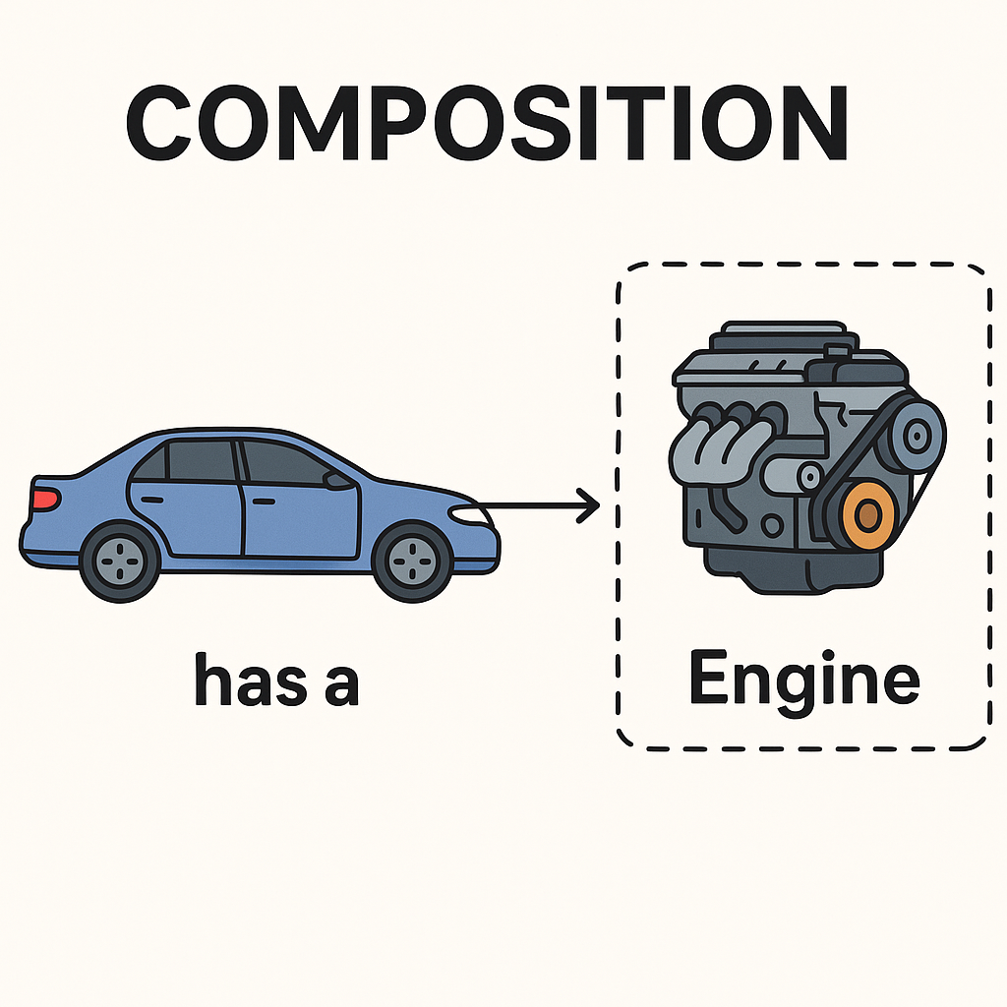
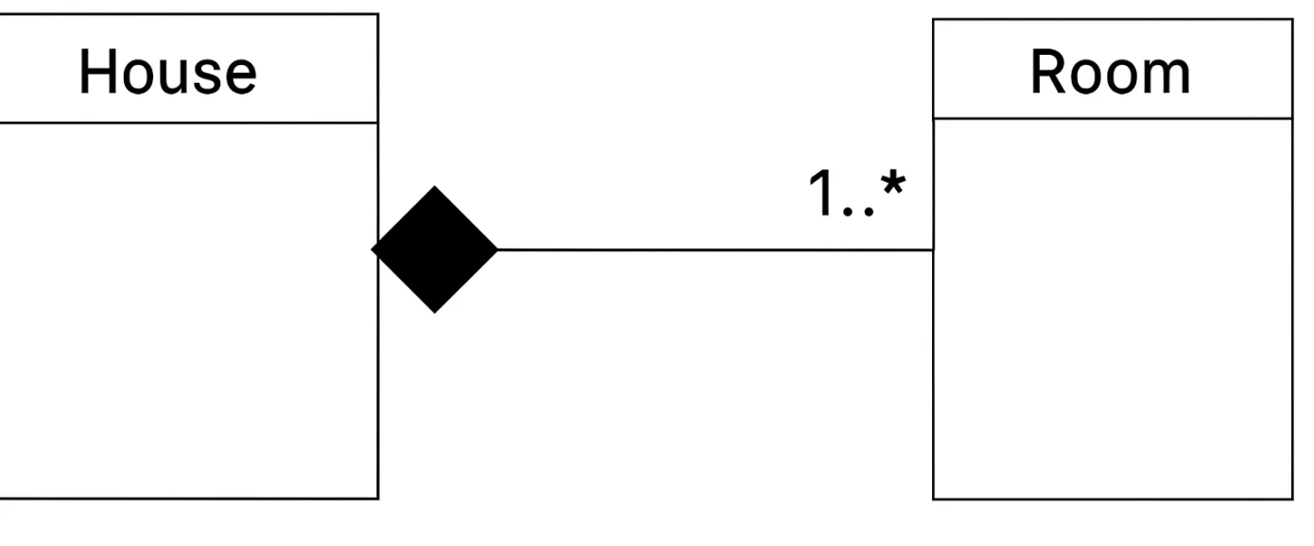
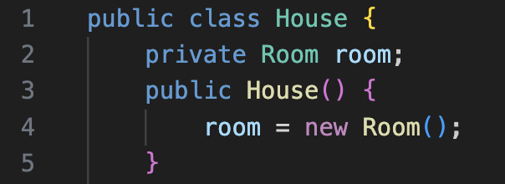
Composition
Strongest dependency.
Whole and parts are tied together.
If whole is destroyed → parts are destroyed.
House ↔ Room (rooms can’t exist without a house).
UML Representation
Straight line with filled diamond on the “whole” side.
Multiplicity 1..* → a house must have one or more rooms.

Slide 4
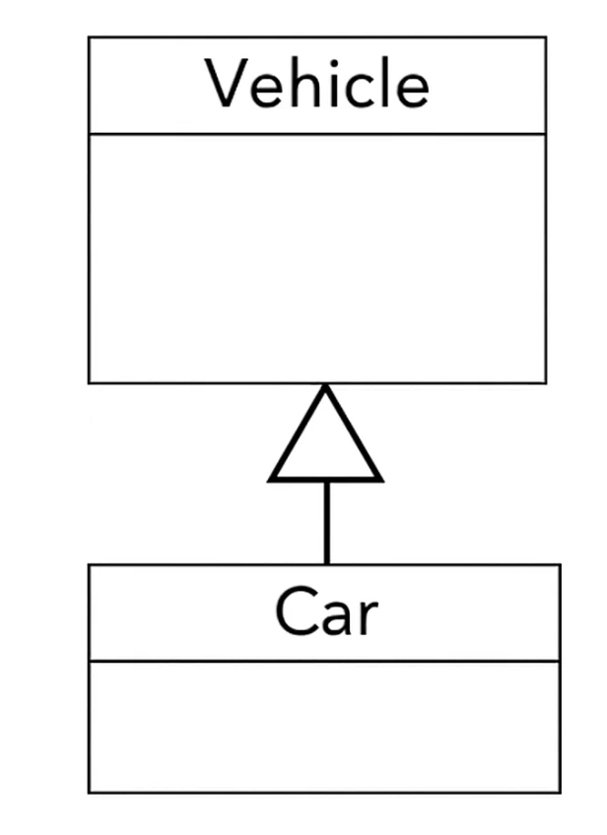
Generalization
Takes repeated or shared characteristics between classes and factors them into a superclass.
Subclasses inherit attributes & behaviors → reduces redundancy and increases reuse.
Superclass = generalized class (common features).
Subclass = specialized class (extra or specific features).

Slide 5
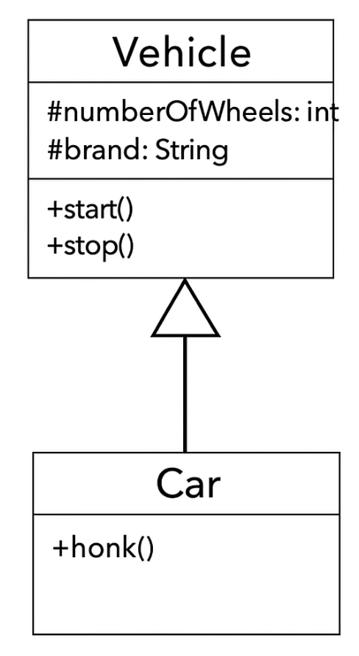
Inheritance and Interfaces in Java
Inherited attributes/methods don’t need to be re-declared in the subclass.
Java uses extends keyword for inheritance.
Superclass prepares attributes; subclass adds specialized features.
Constructors
Implicit Constructor
Provided automatically if you don’t write one.
Attributes set to default values (0, null).

Slide 6
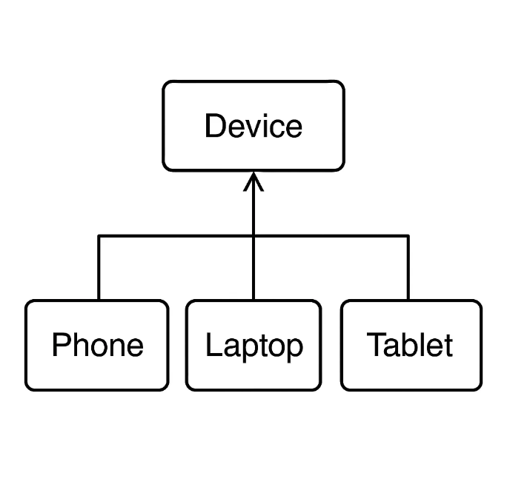
Method Overriding
Subclass can redefine parent’s method.
Phone vs Tablet starting behavior.
Types of Inheritance
Single Inheritance (Java limitation)
-One subclass → one superclass.
Hierarchical Inheritance
-One superclass → many subclasses.
Multilevel Inheritance
-Subclass can also act as a superclass.

Slide 7
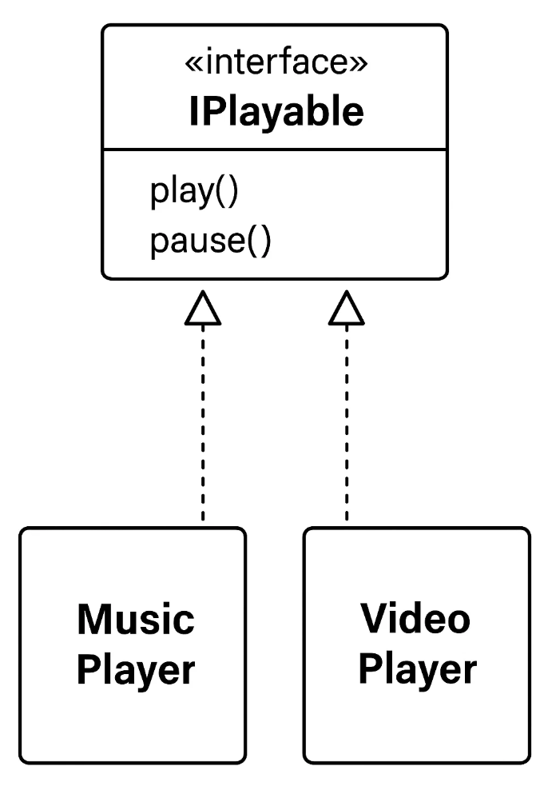
Java Interface
Why Interfaces?
Java does not support multiple implementation inheritance.
Interfaces provide a way for a class to commit to a contract.
Declared with interface, used with implements.
Rules
Only method signatures (no attributes, no constructors).
Any class implementing the interface must define all methods.

Slide 8
Java Interface Cont…
Classes can implement one or more interfaces at a time.
Interfaces allow the creation of programs with reusable and flexible code.
It is important to remember, however, that you should not generalize all behavioral contracts into interfaces.
Interfaces fulfill a specific need: to provide for a way for related classes to work with consistency.
Notes:
. shared, consistent behavior across multiple unrelated classes.

Slide 9
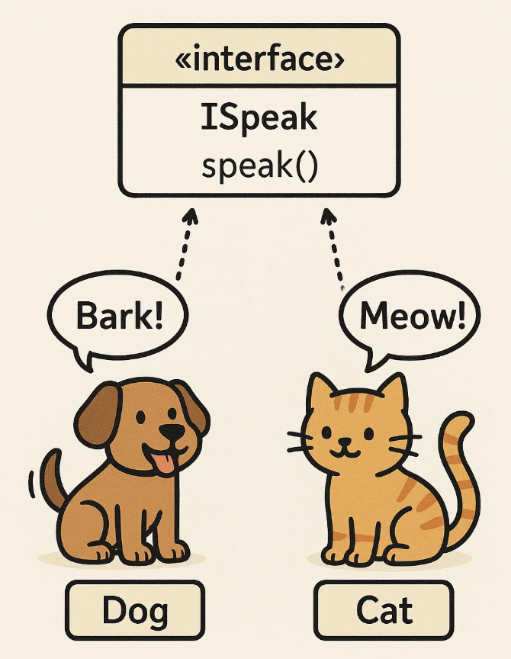
Polymorphism via Interface
Multiple classes can implement the same interface differently.
Example: Cat, Dog
Interfaces can inherit from other interfaces, but interfaces should not be extended.
A single implementation for multiple interfaces with overlapping contracts is acceptable.

Slide 10
Type of Complexities
Essential Complexity
Essential complexity refers to the inherent difficulty of the problem you are trying to solve.
It is the complexity that comes directly from the real-world domain and cannot be removed.
This type of complexity is tied to business rules, user requirements, and core logic.
Example: In banking software, handling interest calculation and fraud detection are essential complexities.

Slide 11
Type of Complexities Cont…
Accidental Complexity
Accidental complexity is the extra difficulty caused by tools, technologies, or poor implementation choices.
It does not come from the problem itself, but rather from how we choose to solve it.
This complexity can be reduced or eliminated with better languages, frameworks, or design practices.
Eg. Choosing a low-level programming language when a higher-level one would be easier, or having badly structured code increases accidental complexity.

Slide 12

Evaluating Design Complexity
It is important to keep modules simple when you are programming.
If design complexity exceeds what developers can mentally handle, then bugs will occur more often.
Design complexity applies to both classes and the methods within them.
Modules
A good design allows any modules to connect together without much trouble.
Design complexity is often measured by coupling and cohesion.

Slide 13
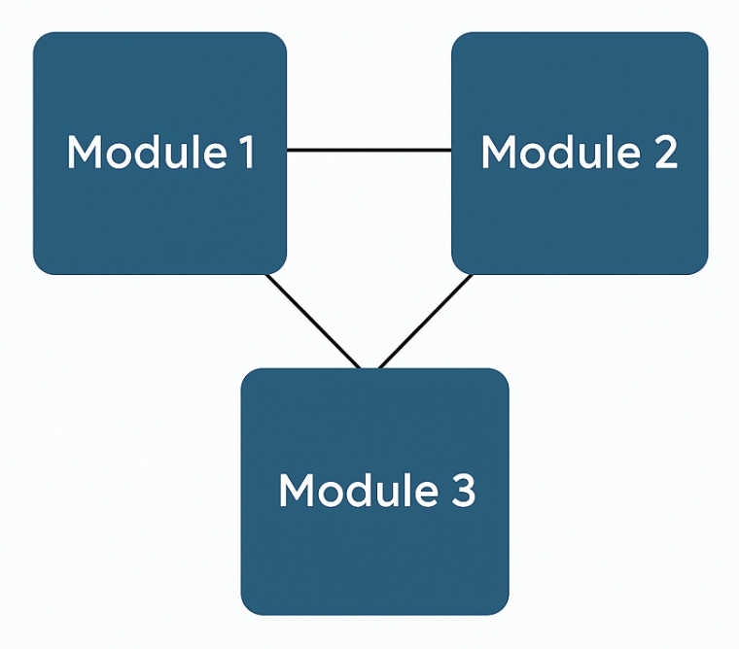
Coupling
Coupling refers to the degree of dependency between different modules or components of a software system.
When two modules are tightly coupled, a change in one may require changes in the other, making the system harder to maintain and scale. – bad design
In software design, we aim for low coupling, which means keeping modules as independent as possible. This allows teams to modify, test, or replace parts of the system without affecting others. – good design

Slide 14
Evaluating Coupling of a Module
Degree is how many connections a module has; fewer connections mean looser coupling.
Ease means connections should be simple and not require knowing other modules’ details.
Flexibility means modules can be easily replaced with better ones in the future.
Signs of tight coupling and bad design are:
A module connects to many others using lots of parameters or interfaces.
It’s hard to find related modules.
A module can only work with specific others.

Slide 15
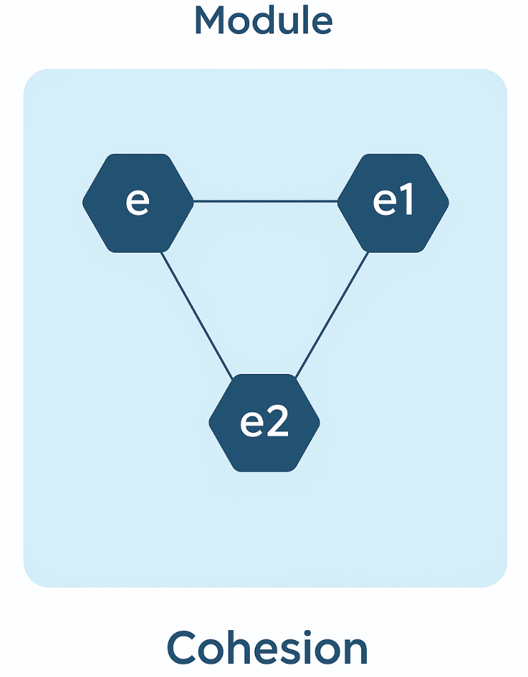
Cohesion
Cohesion describes how closely related and focused the responsibilities of a single module are.
A module with high cohesion performs a single, well-defined task, making the code easier to understand, test, and reuse. – Good Design
We strive for high cohesion, because it leads to better organized, more maintainable systems where each part has a clear and specific role.
If a module has more than one responsibility, it is a good idea to split the module.
Good design balances low coupling with high cohesion, though improving one may affect the other.

Slide 16
Separations of Concerns
Decomposition splits a system into parts and is based on the principle of separation of concerns.
A concern is anything important for solving a problem.
Separation of concerns means keeping different concerns apart.
In software, each concern should be handled in its own part.
This approach supports key object-oriented principles and helps create modular, reusable, and flexible code.

Slide 17
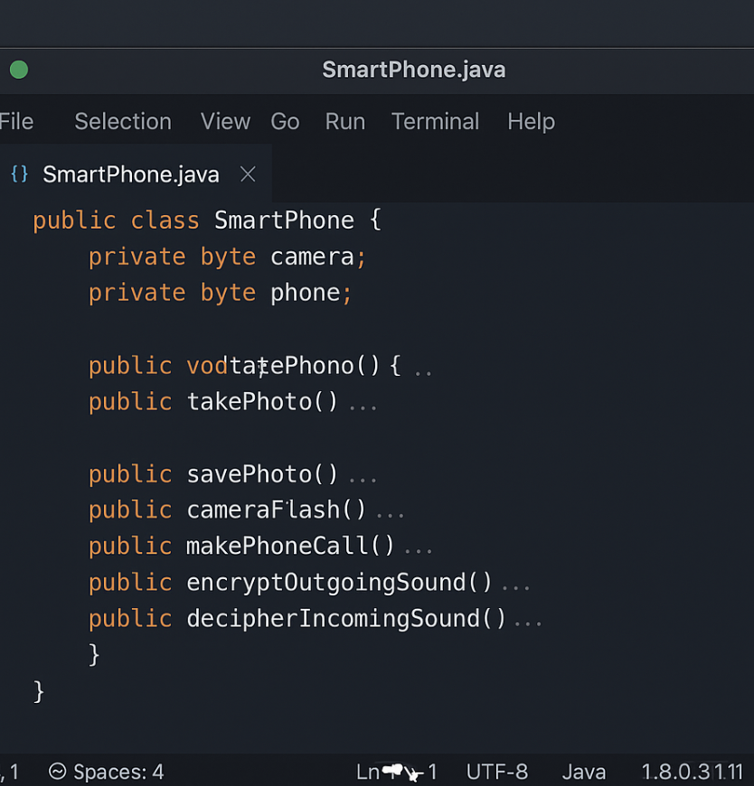
Separations of Concerns example
The SmartPhone class has two attributes
But mixes unrelated behaviors, leading to
Low cohesion and poor modularity.
The class should apply separation of concerns, giving each component its own distinct functionality

Slide 18
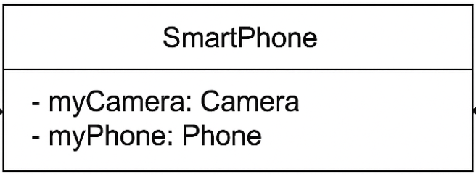
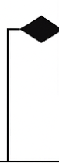
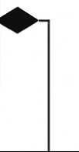
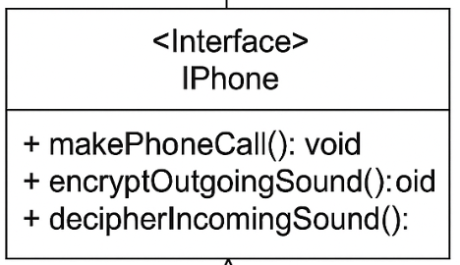
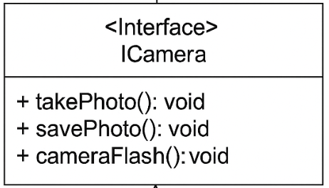
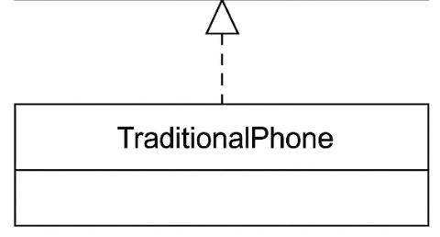
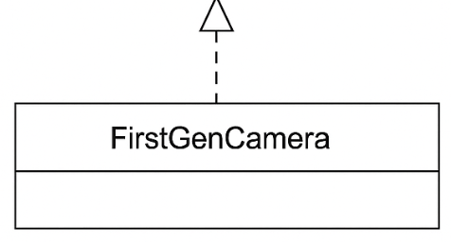
Separations of Concerns example Cont..
The SmartPhone class has two main concerns:
Acting as a traditional phone.
Taking pictures with a camera.
These should be separated into their own cohesive classes (Phone and Camera.
The SmartPhone class would then serve as a coordinator, referencing these classes to provide full functionality without managing their internal details.

Slide 19
Information Hidding
Expose only what a module/class must expose to be used correctly; hide everything likely to change (algorithms, data representation).
Reveal stable assumptions via interfaces/APIs. Encapsulation is the mechanism that enforces this (private fields, public methods).
Examples:
Banking Account: balance is private; only deposit()/withdraw() public
Image library hides compression algorithm; API stays the same
Sorting service exposes sort(List); swaps QuickSort ↔ MergeSort internally

Slide 20
Conceptual Integrity
A system should feel like it was designed by one mind: consistent naming, patterns, architecture, and conventions—even with many contributors.
Communication rituals, code reviews, clear architecture, unifying concepts, a core maintainers group.
Examples:
Project-wide naming like findById, not getOne/fetch/lookup mixed
All services use REST+JSON with common error format
UNIX “everything is a file” → one model, many resources

Slide 21
Decomposition Principle
Use inheritance only when the subtype is a true specialization of the supertype and obeys Liskov Substitution (can stand in for its parent without breaking expectations).
Smells of misuse:
Subclass adds nothing unique (just reuses fields/methods)
Subclass overrides behavior to contradict parent’s contract
You’re using inheritance just to share code (prefer composition)
Examples:
Manager extends Employee (adds team/approveLeave)
Whale extends Animal that requires run()—breaks LSP

Slide 22
Thank You☺

